Slide 1

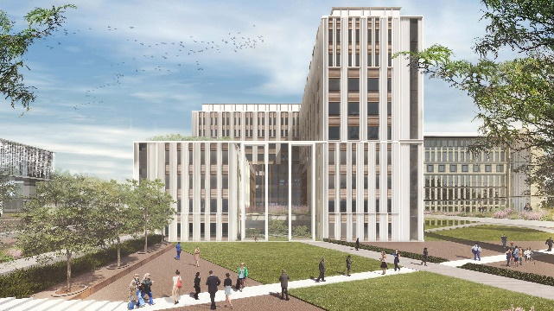
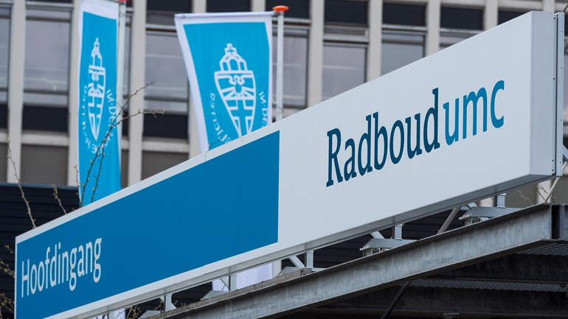
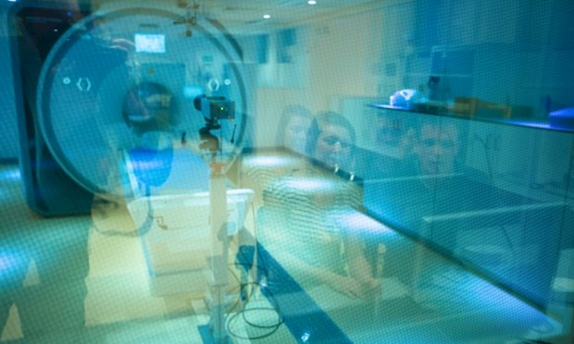
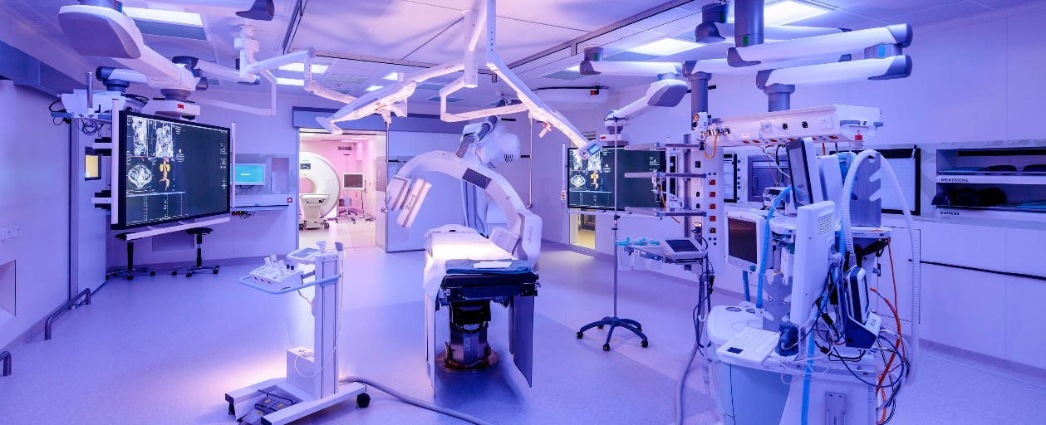

Dutch registry of Invasive coronary function testing in INOCA
Peter Damman, MD PhD FESC
Interventional Cardiologist
Radboudumc, Nijmegen, the Netherlands

Slide 2
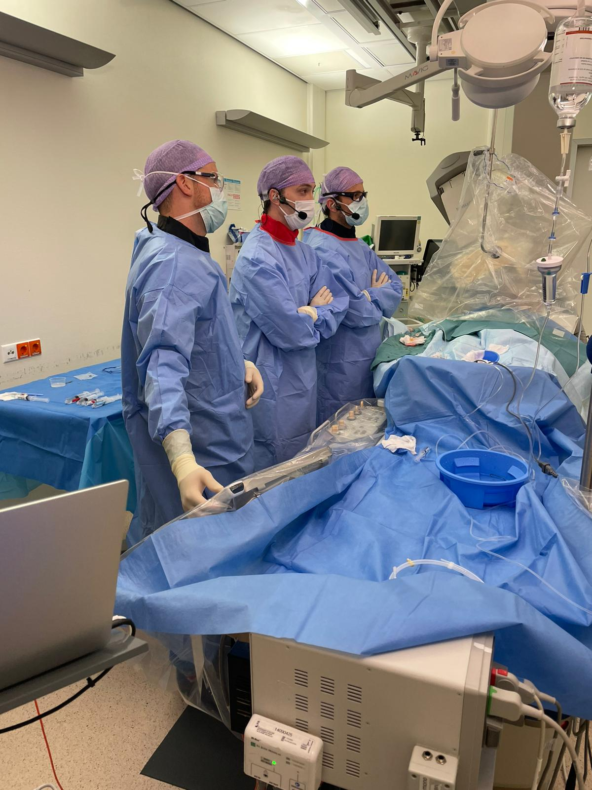
Objectives NL-CFT
Quality control
Diagnostic value of CFT
Outcomes after CFT
Source for research
Registry based research for participating centers
Registry based randomised trials
To improve
Understanding of pathophysiology
Diagnosis
Treatment

Slide 3
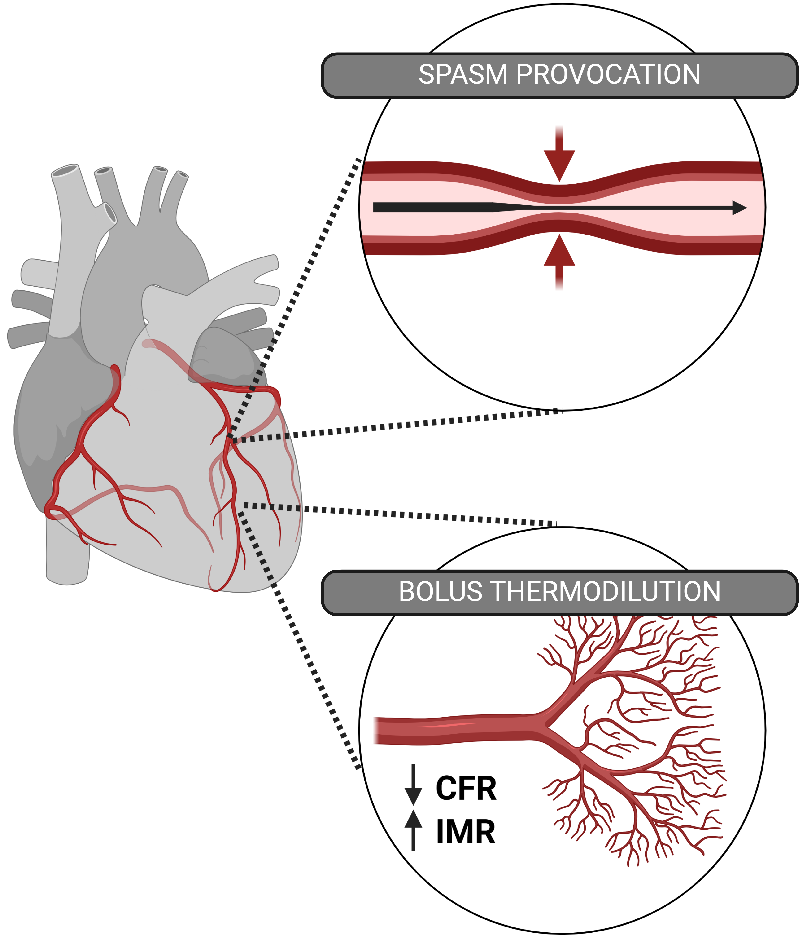
Coronary function test
Possible CFT outcomes
 | No spasm | Epicardial spasm | Microvascular spasm
Normal CFR/IMR | Normal CFT | Epicardial spasm | Microvascular spasm
Abnormal CFR/IMR | Microvascular dysfunction (CMD) | Epicardial spasm with CMD | Microvascular spasm with CMD

Slide 4
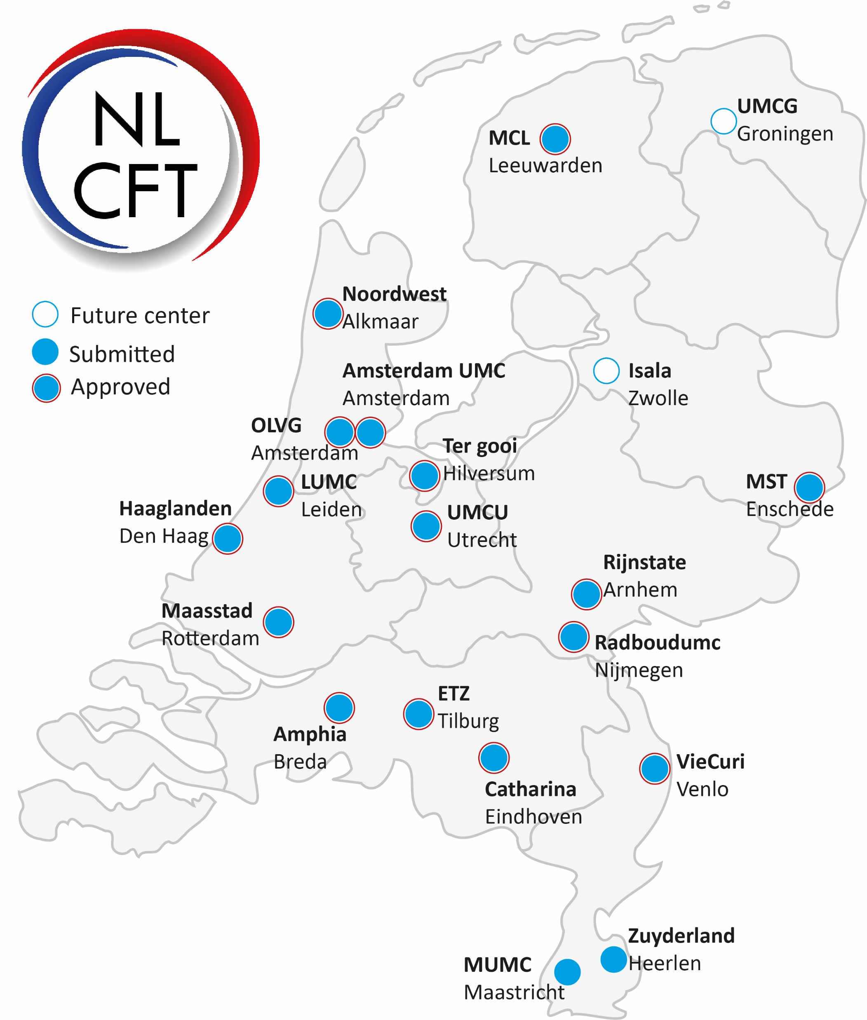

Slide 5
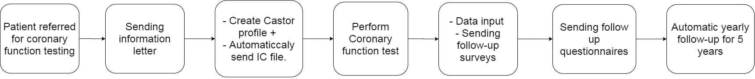
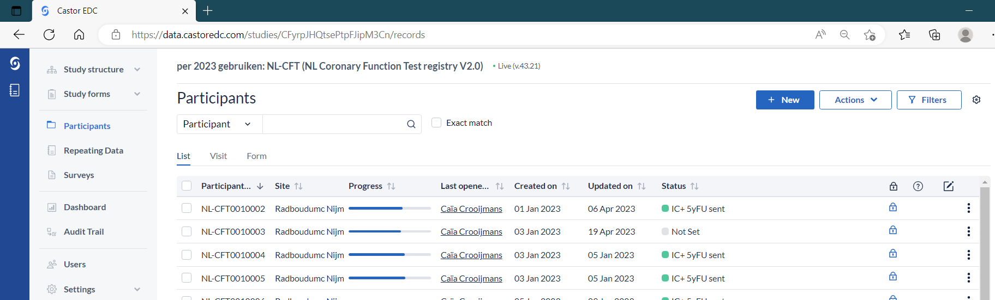
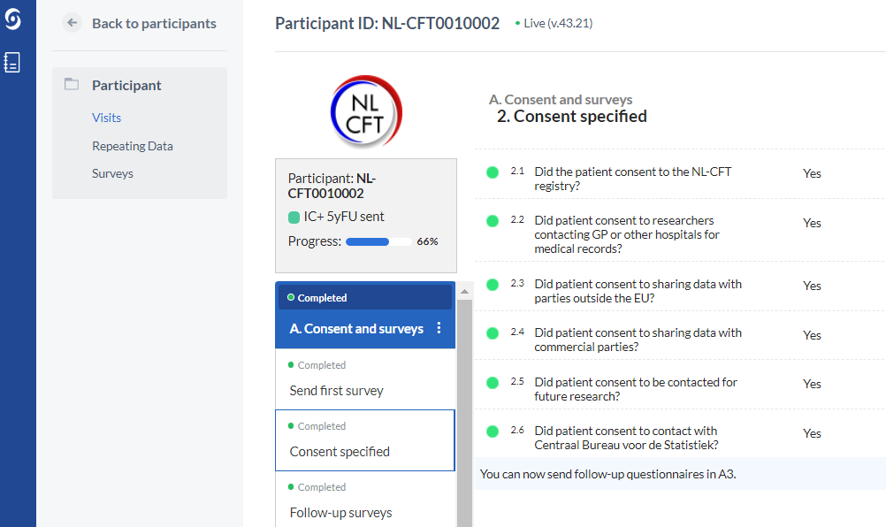
Workflow NL-CFT

Slide 6
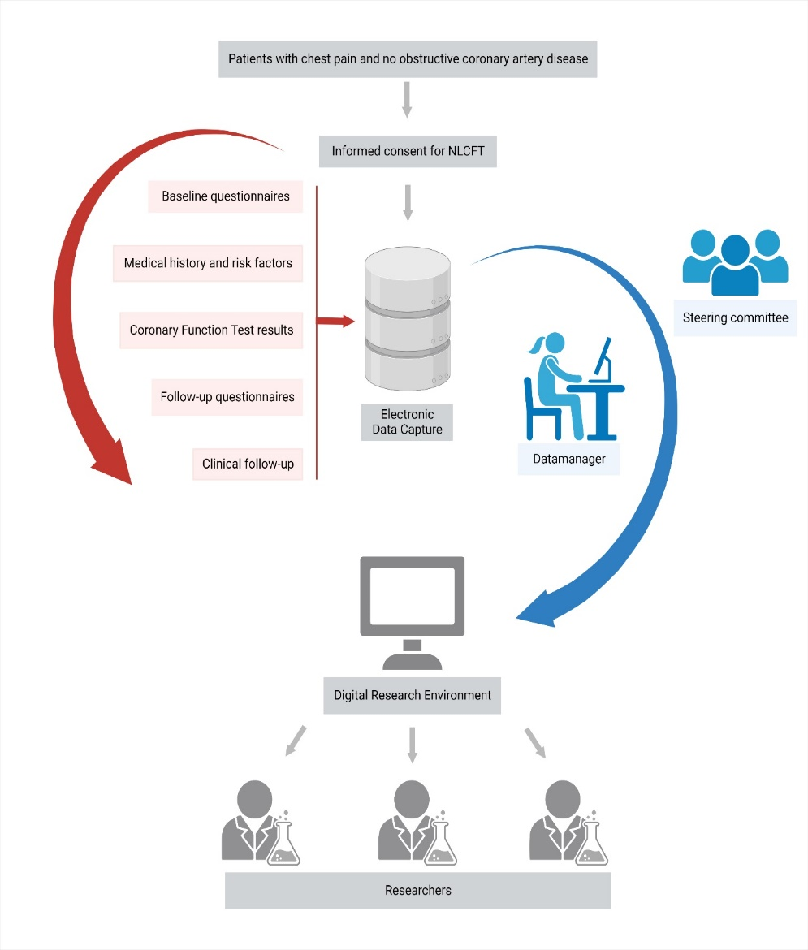

Slide 7
NL-CFT experience
Registry
Started in 2021
Currently, over 2000 CFTs
First manuscripts published
First follow-up manuscripts in preparation

Slide 8
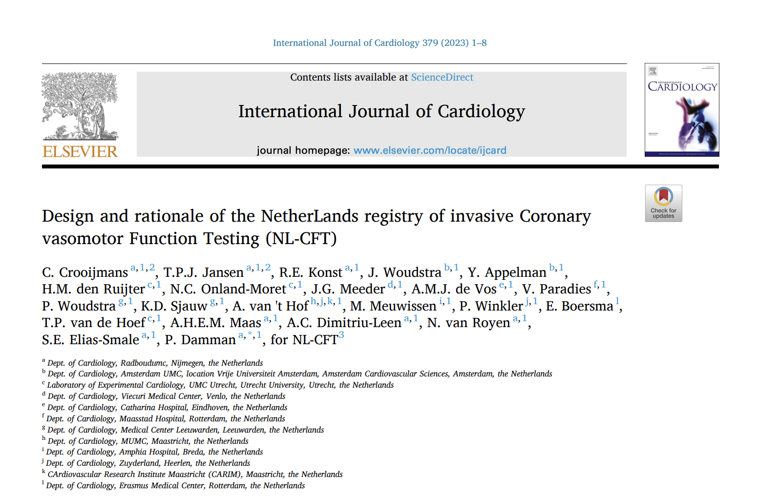

Slide 9
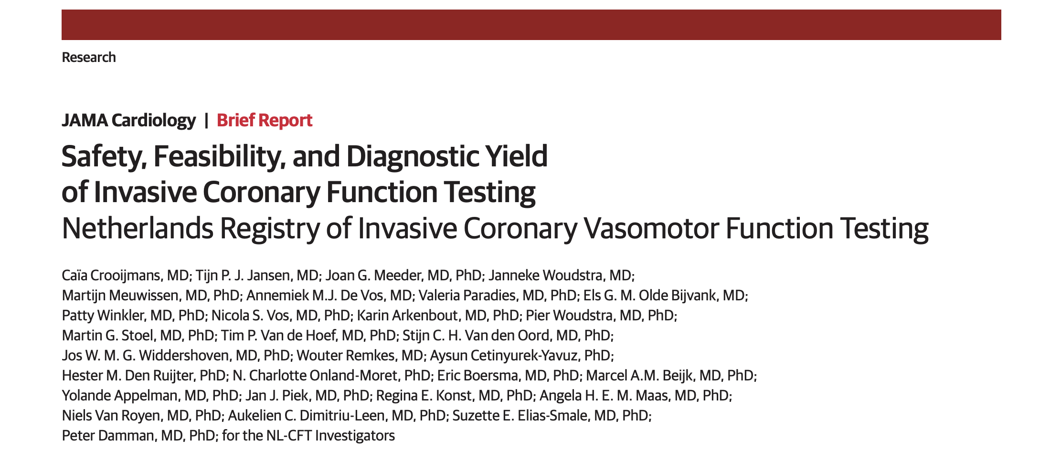

Slide 10
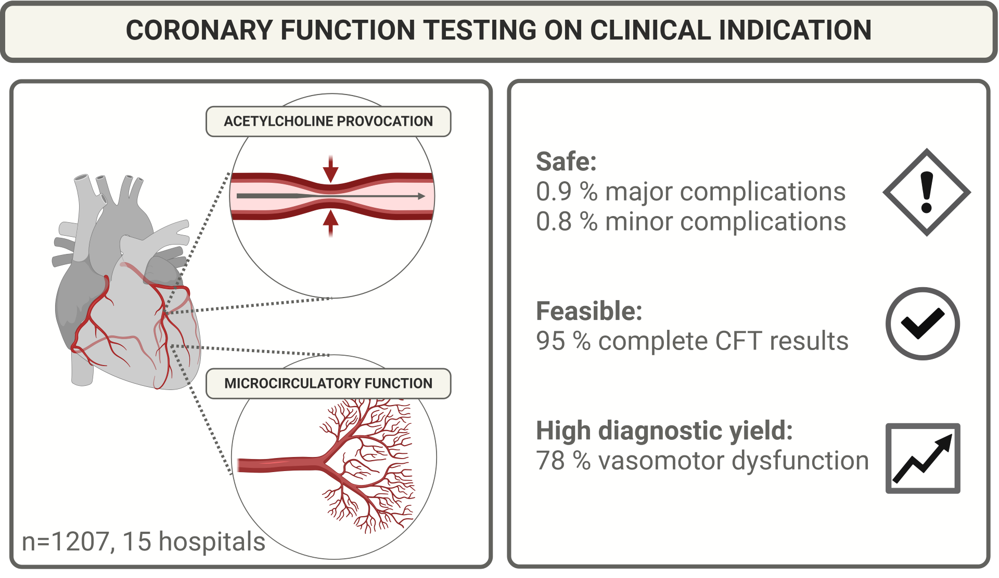
Safety and diagnostic yield
Safety and diagnostic yield
Safe
0.9% major complications
0.8% minor complications
Feasible
95% complete CFT results
High diagnostic yield
78% vasomotor dysfunction
Crooijmans, JAMA Cardiology 2025

Slide 11
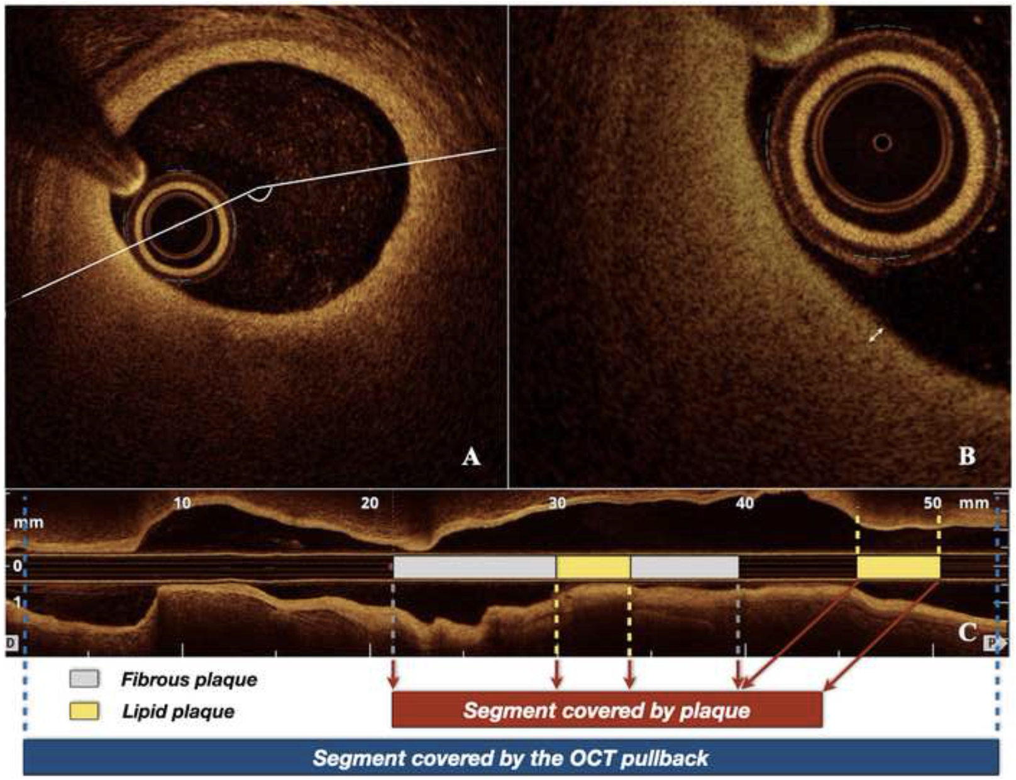
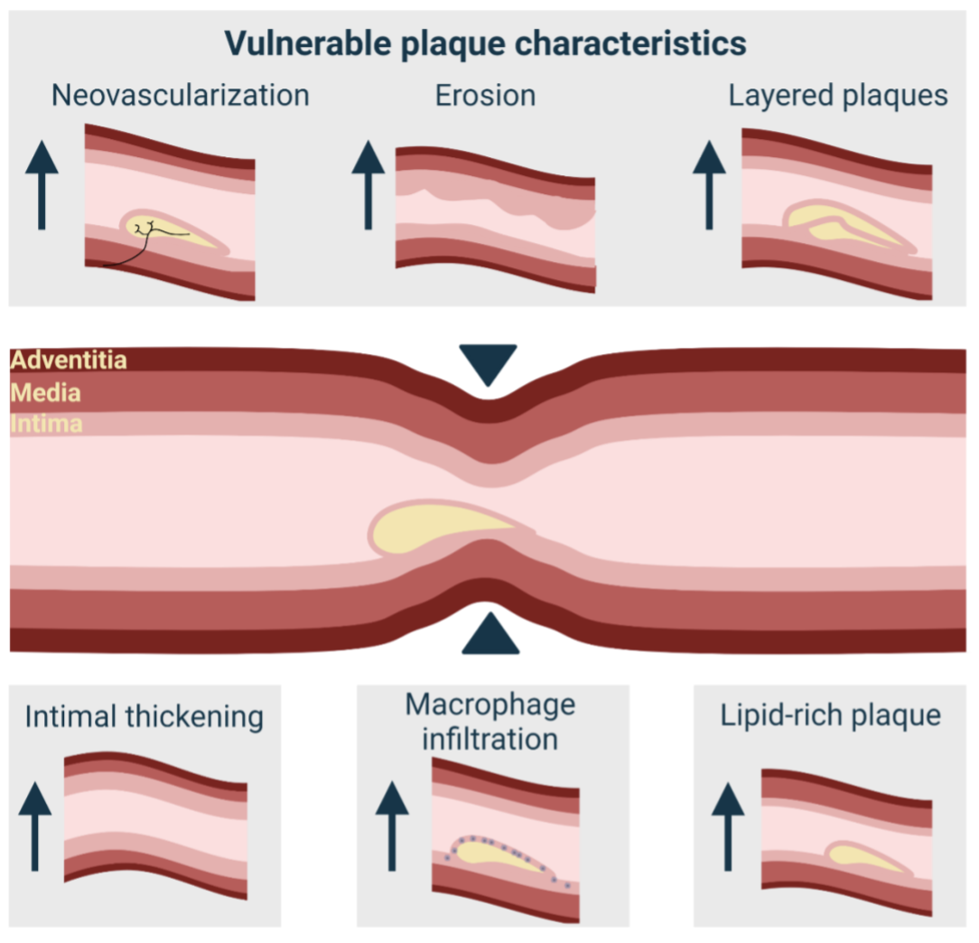
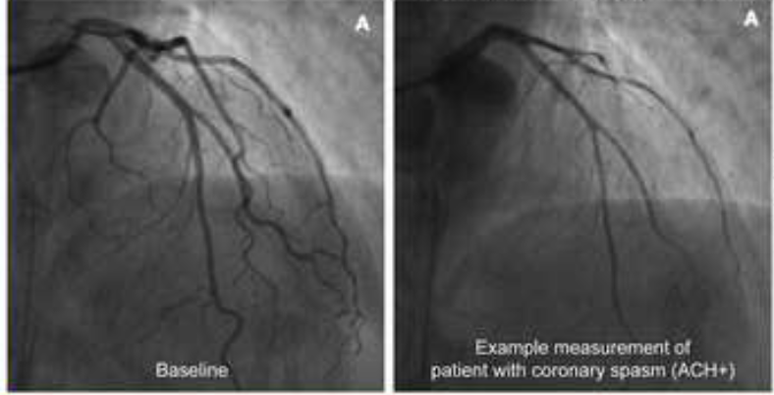
Pathophysiology: Association between vasospasm and atherosclerosis
Pellegrini, Eurointervention 2022; Peters, JACC CI 2024

Slide 12
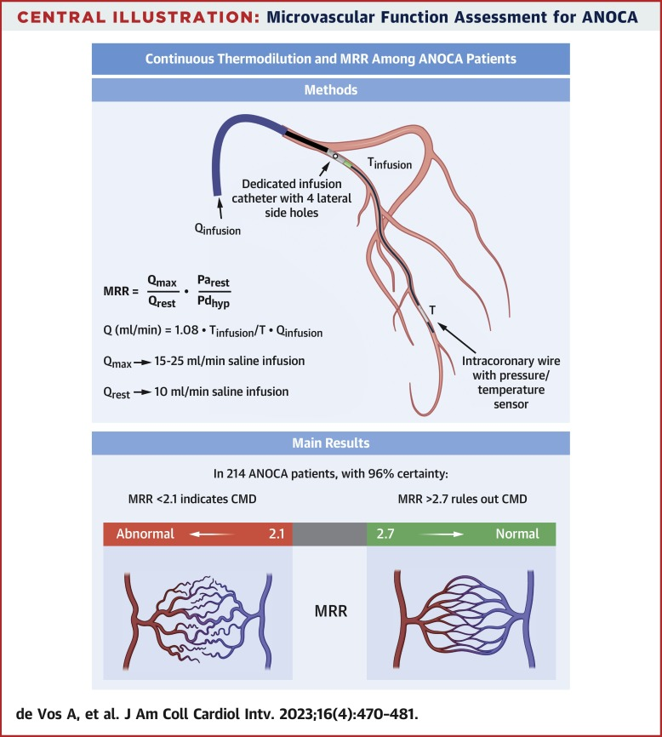
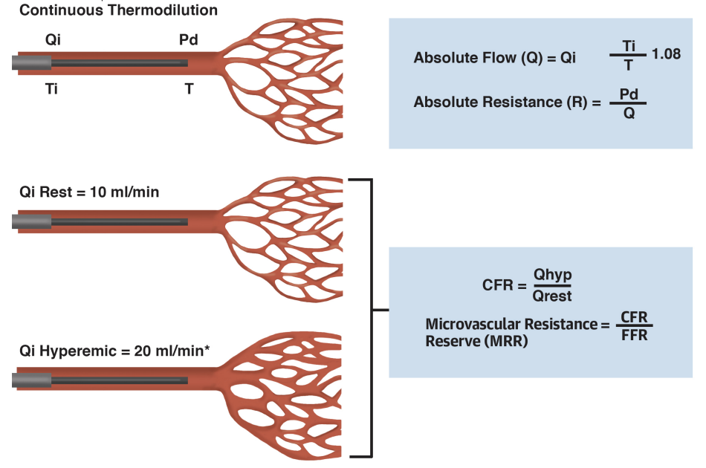
Diagnostics: continuous thermodilution
Konst, JACC 2021; Jansen, JACC 2021; de Vos, JACC CI 2023

Slide 13
NL-CFT experience
Registry
Started in 2021
Currently, over 2000 CFTs
First manuscripts published
First follow-up manuscripts in preparation
Registry based RCT
EDIT-CAS, started
EDIT-CFT in preparation

Slide 14

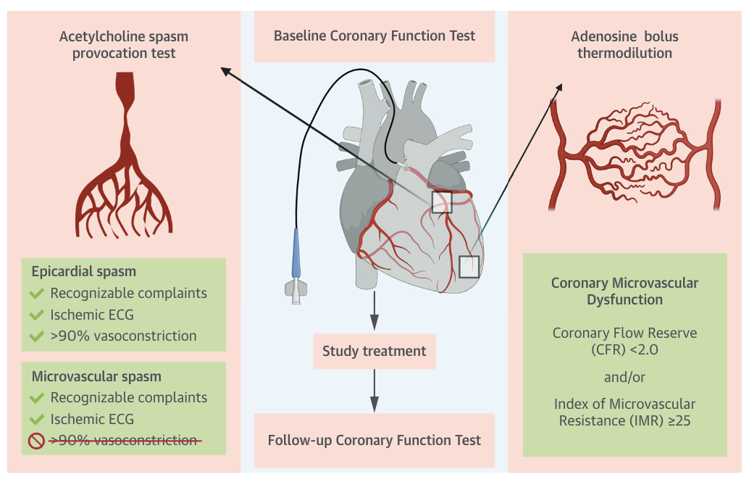
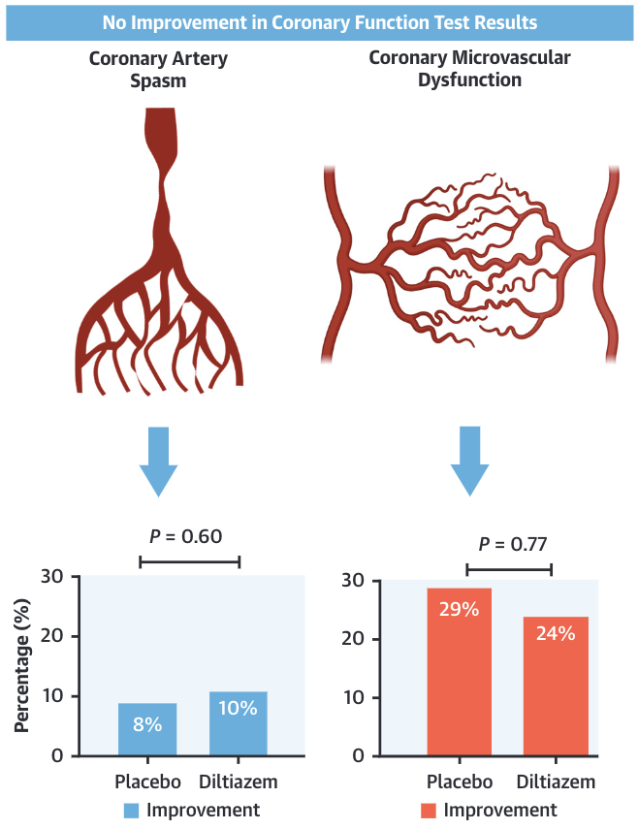
Treatment: EDIT-CMD
Jansen, JACC CI 2021
Notes:
EDIT-CMD: intrapatient follow-up

Slide 15
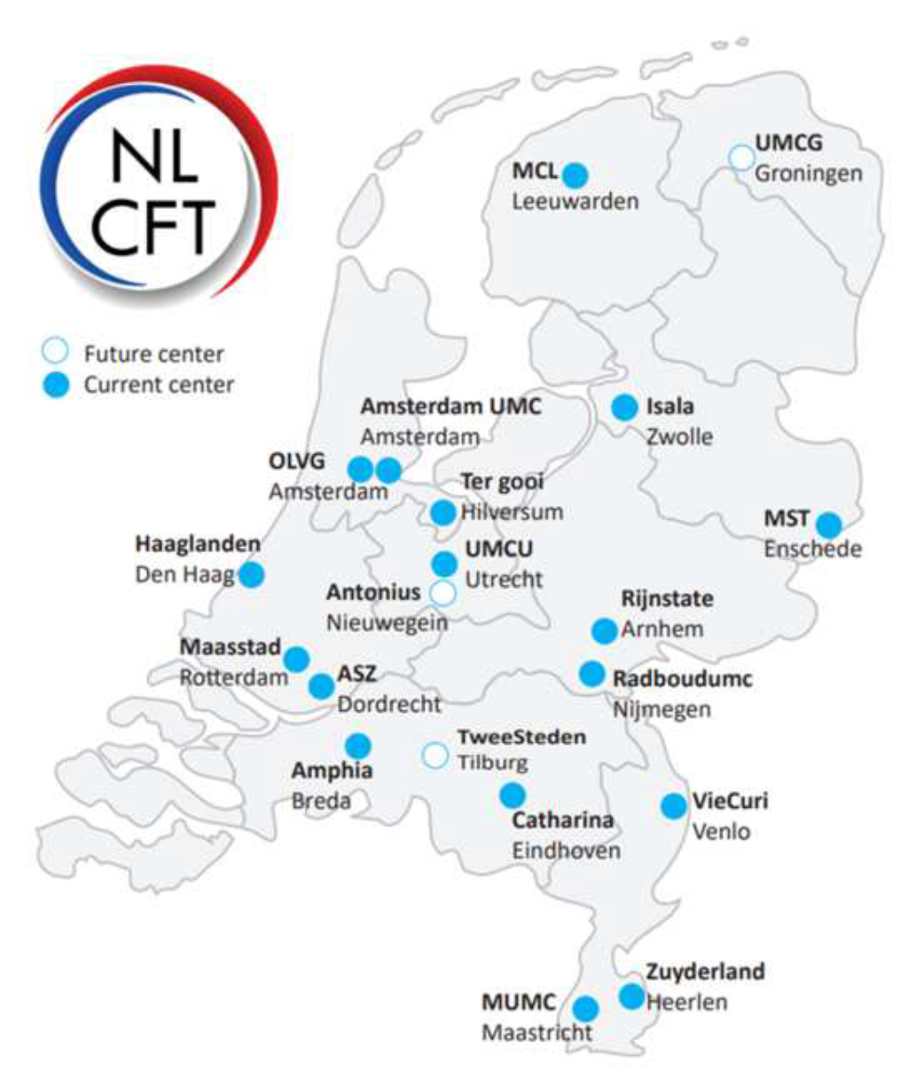
Novel trials: Registry based RCTs
COMPLETED
COLCOT
Colchicine versus placebo
CAS
CFT
Bosentan versus placebo
Routine versus selective CFT

Slide 16
Thank you, questions?
'Als ik zou willen dat je het begreep, had ik het wel beter uitgelegd. ’
Cruijff

